Slide 1
Zigbee

Slide 2
What is ZigBee?
Technological Standard Created for Control and Sensor Networks
Based on the IEEE 802.15.4 Standard
Created by the ZigBee Alliance

Slide 3
IEEE 802.15.4
Zigbee is set of high level communication protocols based upon the specification produced by 802.15.4 - standard for wireless personal area networks (WPANs)

Slide 4

IEEE 802.15.4 & ZigBee In Context
Application
Customer
“the software”
Network, Security & Application layers
Brand management
IEEE 802.15.4
“the hardware”
Physical & Media Access Control layers
API
Security
32- / 64- / 128-bit encryption
ZigBee
Alliance
Network
Star / Mesh / Cluster-Tree
MAC
IEEE
802.15.4
PHY
868MHz / 915MHz / 2.4GHz
Silicon
Stack
App

Slide 5
WPANs
A personal area network (PAN) is a computer network used for communication among computer devices (including telephones and personal digital assistants) close to one person
A wireless PAN consists of a dynamic group of less than 255 devices that communicate within a range of about a 33-feet.

Slide 6
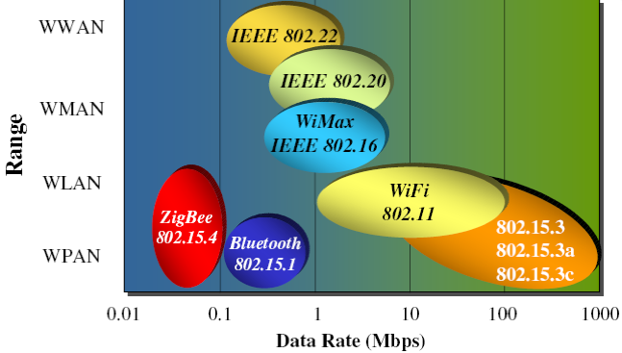
IEEE 802 Wireless Space

Slide 7
ZigBee Aims Low
Low data rate
Low power consumption
Small packet devices

Slide 8
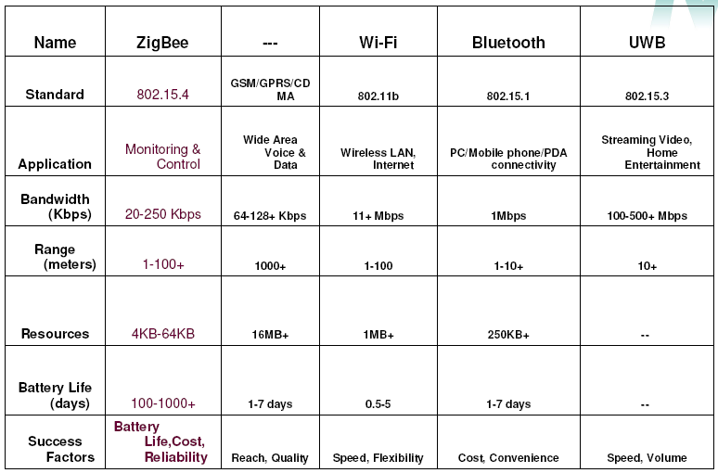
ZigBee Vs Other Wireless Protocols

Slide 9
ZigBee Vs Bluetooth
Bluetooth targets medium data rate continuous duty
– 1 Mbps over the air, ~700 kbps best case data transfer
– File transfer, streaming telecom audio
– Point to multipoint networking
ZigBee targets low data rate, low duty cycle
– 250 kbps over the air, 60-115 kbps typical data transfer
– Long battery life (weeks to months)
– More sophisticated networking

Slide 10
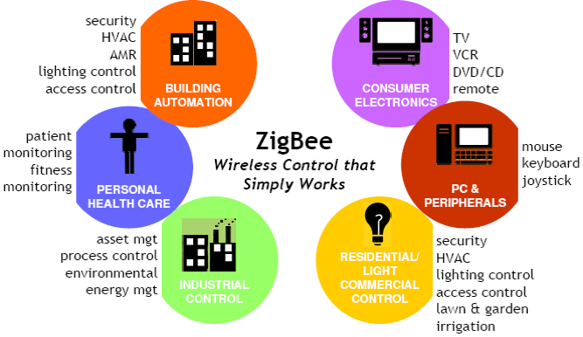
ZigBee Applications

Slide 11
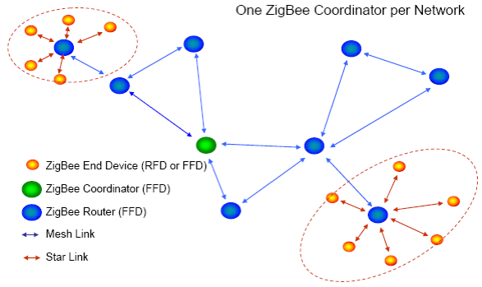
ZigBee Network Model

Slide 12
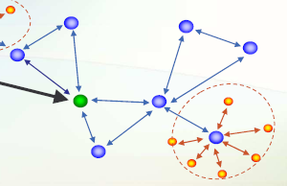
Network Pieces : PAN Coordinator
PAN Coordinator(ZC)
• One and only one in PAN
• “owns” the network
•Starts it
• Allows other devices to join it
• Provides binding and address-table services
• Saves messages until they can be delivered
• And more… could also have i/o capability
• A “full-function device” – FFD
• Mains powered

Slide 13
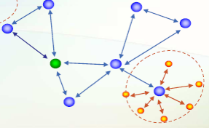
Network Pieces : Router
Routers(ZR)
• Optional element
Routes messages- Participates in multihop routing of messages.
• Does not own or start network
• Scans to find a network to join
• A “full-function device” – FFD

Slide 14
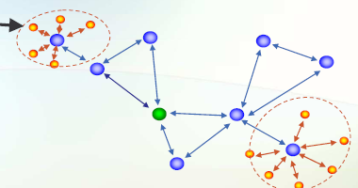
Network Pieces : End Devices
End Device(ZED)
• Optional element
Communicates with a single device, does not participate in routing
• Does not own or start network
• Scans to find a network to join
• Can be an FFD or RFD
• Usually battery powered

Slide 15
IEEE 802.15.4 Device Types
Network Coordinator
Maintains overall network knowledge; most sophisticated of the three types; most memory and computing power
Full Function Device (FFD)
- Carries full 802.15.4 functionality and all features specified by the standard
- Additional memory, computing power make it ideal for a network router function
- Could also be used in network edge devices where the network touches other networks or devices that are not IEEE 802.15.4 compliant
Reduced Function Device (RFD)
- Carriers limited (as specified by the standard) functionality to control cost and complexity
- General usage will be in network edge devices

Slide 16
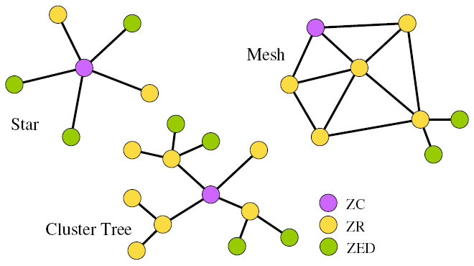
Network Topologies

Slide 17

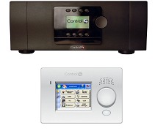
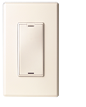

ZigBee Mesh Networking
Slide Courtesy of
Source: http://www.zigbee.org/en/resources/#SlidePresentations

Slide 18
ZigBee Mesh Networking
Slide Courtesy of
Source: http://www.zigbee.org/en/resources/#SlidePresentations

Slide 19
ZigBee Mesh Networking
Slide Courtesy of
Source: http://www.zigbee.org/en/resources/#SlidePresentations

Slide 20
ZigBee Mesh Networking
Slide Courtesy of
Source: http://www.zigbee.org/en/resources/#SlidePresentations

Slide 21
AT Mode(What)
AT mode is synonymous with "Transparent" mode.
In AT mode, any data sent to the XBee module is immediately sent to the remote module identified by the Destination Address in memory.
If the XBee that the data is sent to is the Coordinator it will broadcast on the PanID.
No packet formation is necessary, but rather simple send Serial data to the tx of one Xbee and it will be received by the rx of the destination XBee

Slide 22
AT Mode(Why?)
If you are new to XBees this is the fastest way to start transmitting
If you only communication between two XBees
If you can implement an external protocol

Slide 23
API Mode(What)
API mode is "Application Programming Interface"
Data must be formatted in frames with Destination information and payload
The API is an alternative to the default transparent mode.

Slide 24
API Mode(why?)
For larger networks that involve nodes talking to multiple targets
If XBees are gathering data without a mbed attached and thus can not format their own data before sending
If power is a big concern and you would like End Devices to 'sleep' until data is requested.
Need to change parameters without entering command mode (XBee only)
Want to view RSSI and source address on a packet by packet basis
Would like to receive packet delivery confirmation on every transmitted packet

Slide 25
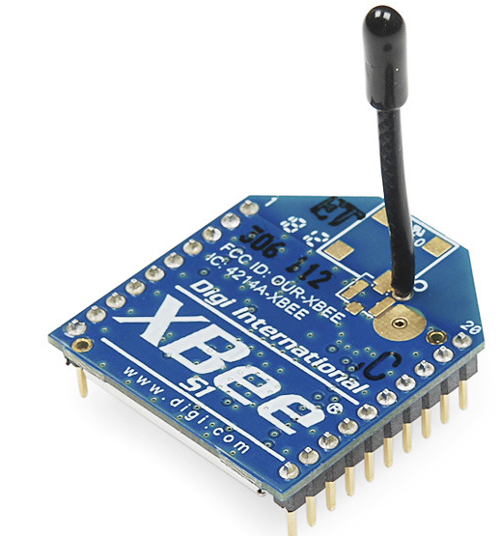
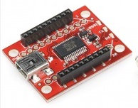
Simple Chat using AT mode

Slide 26
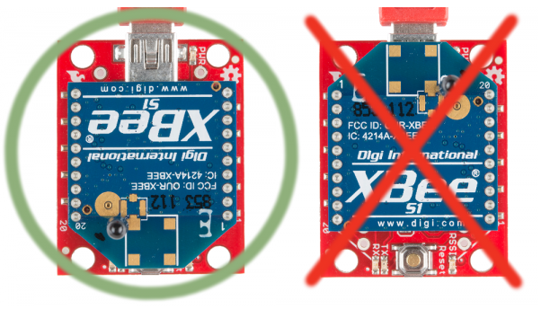
Basic Assembly: Plug In an XBee!

Slide 27
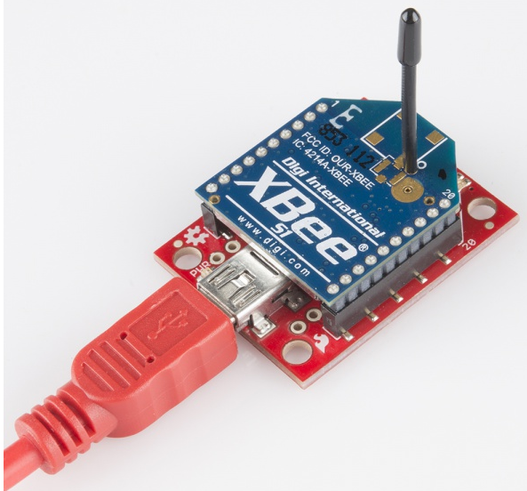
Connect to computer..

Slide 28
Zigbee point to point communication
1st xbee as router
Set PAN ID(Say 1234)
Note SH, SL
Use SH, SL of coordinator as DH, DL of router
2nd xbee as coordinator
Set same PAN ID(Say 1234)
Note SH, SL
Use SH, SL of coordinator as DH, DL of router

Slide 29
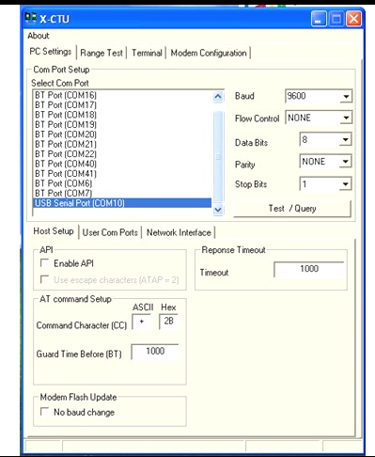
Launch X-CTU

Slide 30
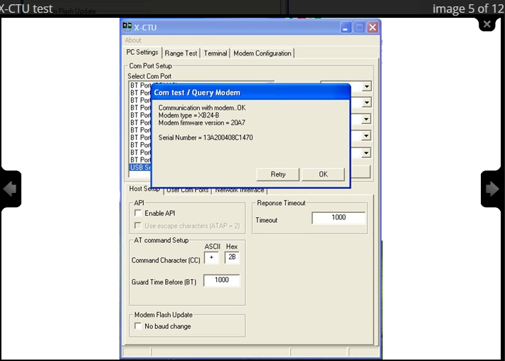
X-CTU Test

Slide 31
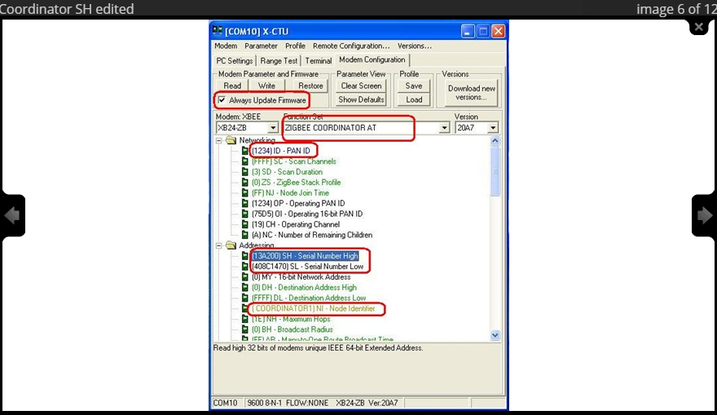

Slide 32
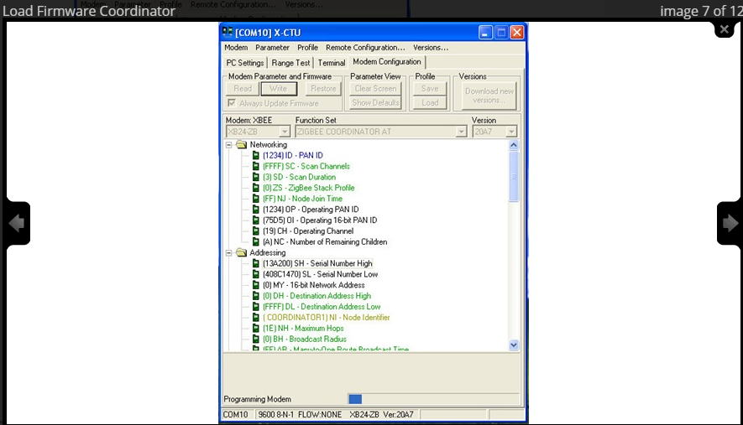

Slide 33
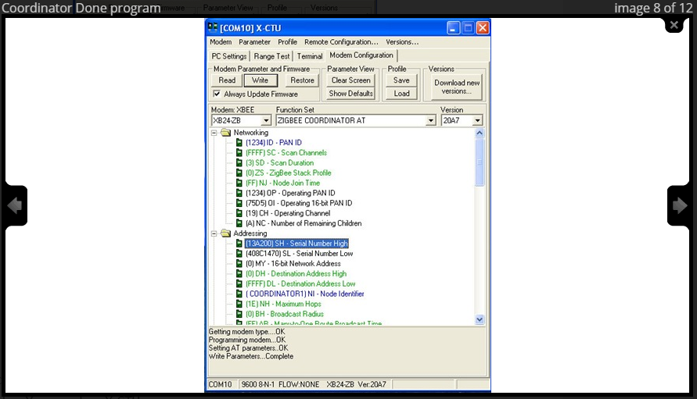

Slide 34
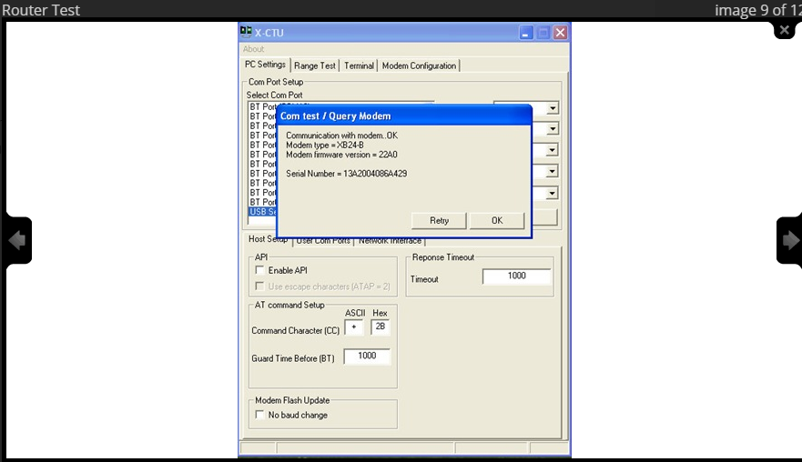
Router Configuration

Slide 35
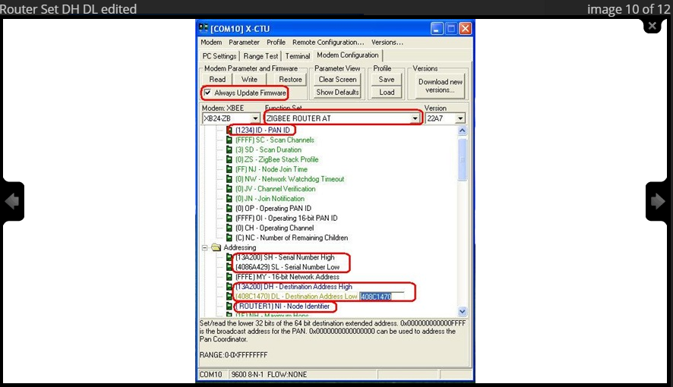

Slide 36
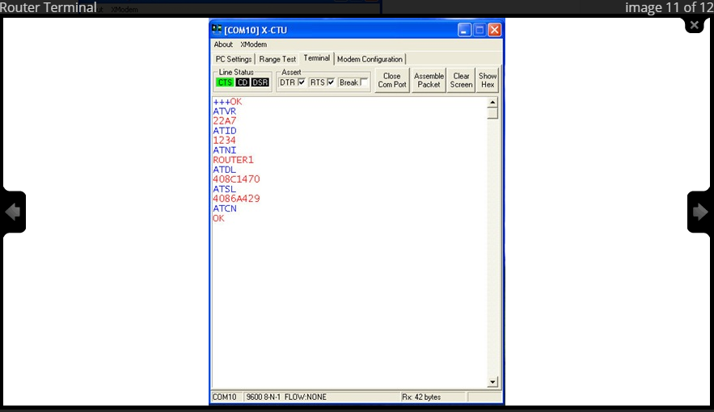
Router Terminal

Slide 37
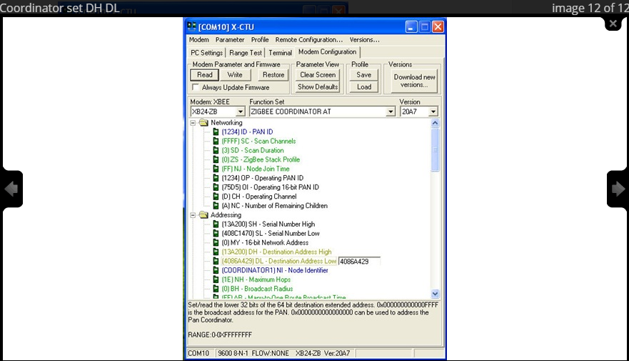
Coordinator set DH DL

Slide 38
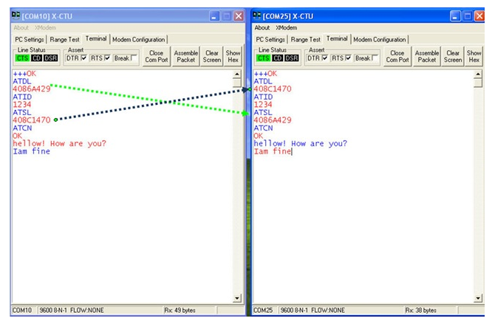
Communication

Slide 39
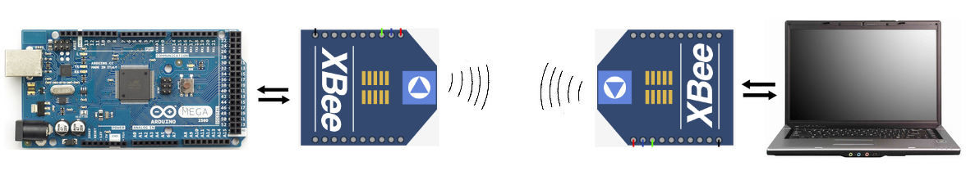
Communicate with Arduino

Slide 40
Router AT- Coordinator API
Components:
Arduino
2 XBEE modules
1 magnetic door lock
Breadboard
Resistor

Slide 41
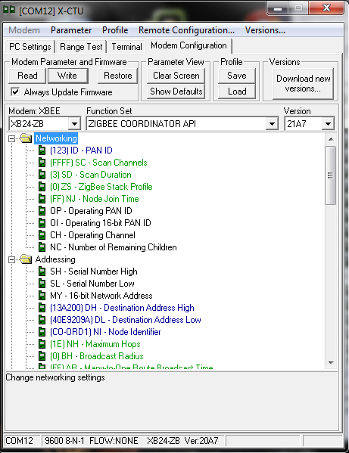
Coordinator-API configuration

Slide 42
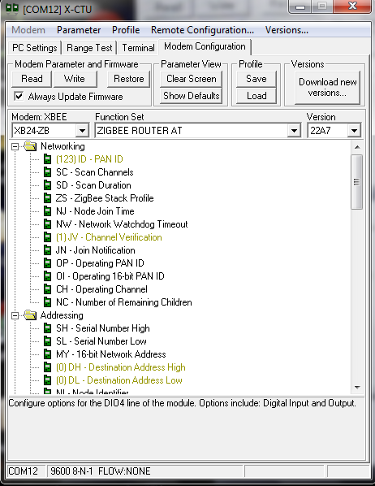
Router-AT Configuration(1):
v

Slide 43
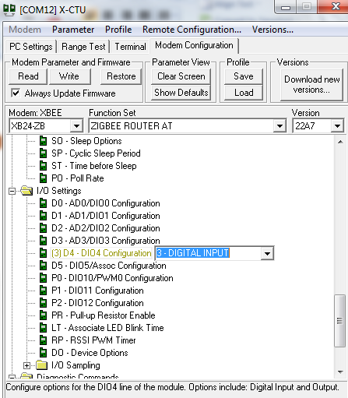
Router-AT configuration(2)
v

Slide 44
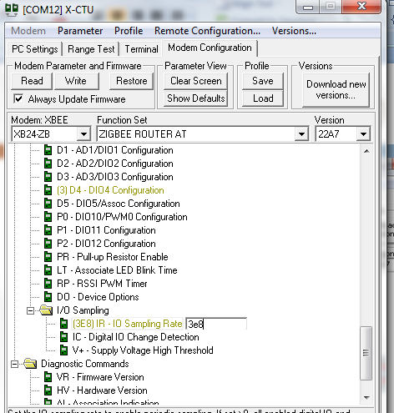
Router-AT Configuration(3):
v

Slide 45
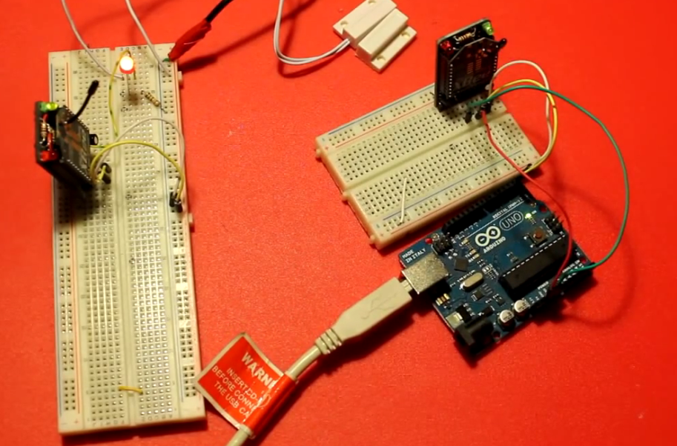
Router AT- Coordinator API

Slide 46
Co-ordinator Arduino Program:
void loop() {
if(mySerial.available()>21){
for(int i=0;i<22;i++){
Serial.print(mySerial.read(), HEX);
Serial.print(",");
}
Serial.println();
}
// put your main code here, to run repeatedly:
}

Slide 47
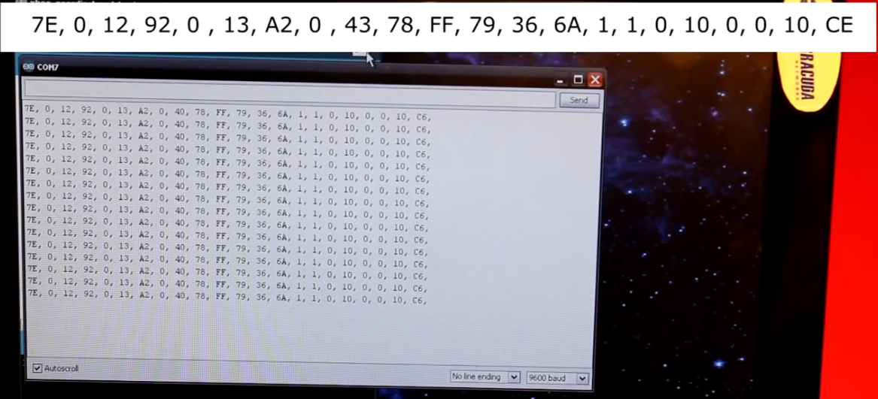
Output:

Slide 48
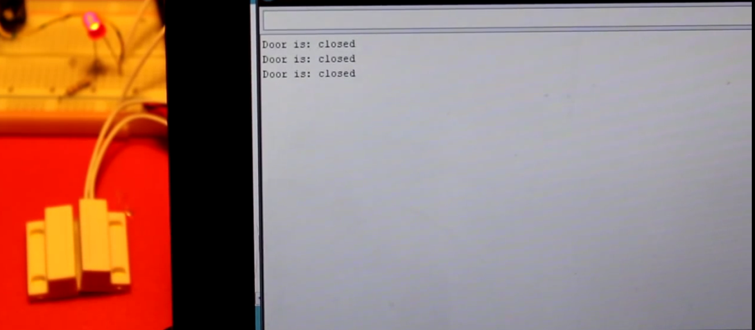
Output: Initially

Slide 49
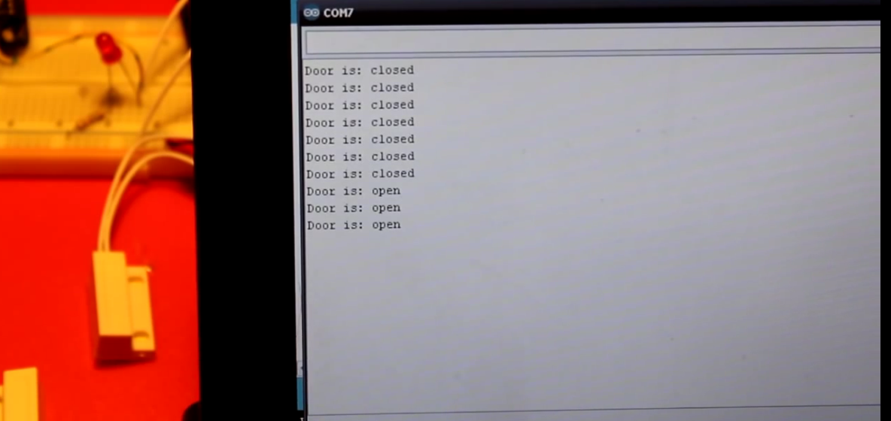
Output: when disconnected

Slide 50
References
http://tutorial.cytron.com.my/2012/03/08/xbee-series-2-point-to-point-communication/
https://learn.sparkfun.com/tutorials/exploring-xbees-and-xctu
http://www.learnerswings.com/2014/03/communication-between-xbee-connected-to.html

